Slide 1



Slide 2

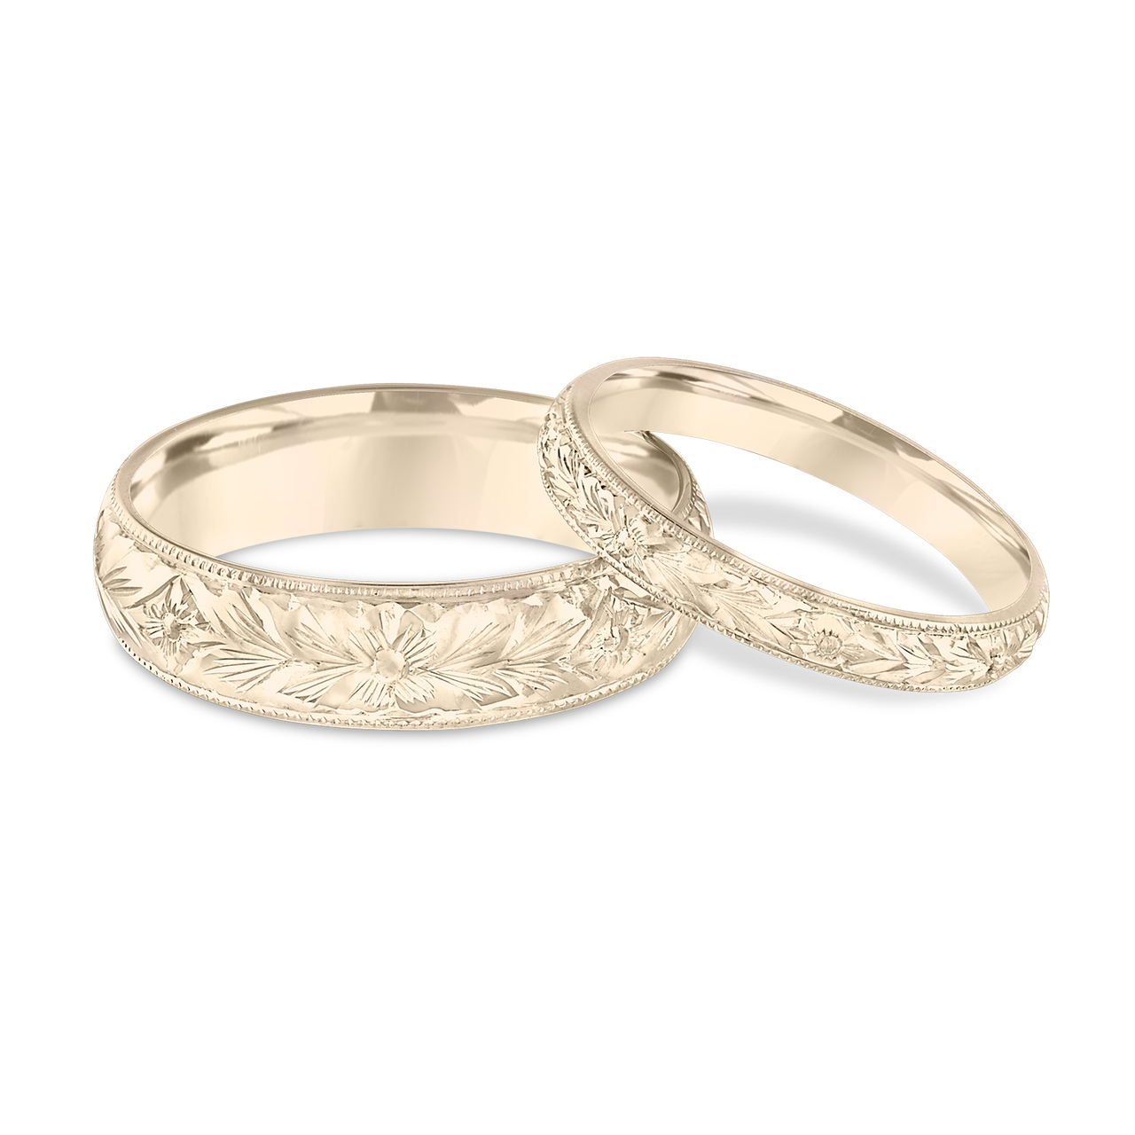
Light Lesson 19 Walking in the Light: Marriage Building Your Dream Home (Part 2)

Slide 3

Introduction
Ephesians 5:8 teaches us, who in the past were in darkness, to walk as children of light.
We want to walk as children of light in our marriages, knowing God will bless us in our obedience.
The eyes of our heart allow us to envision what God wants us to practice in our marriages as we study the scriptures.
So often couples put far more thought into building their dream “house” than they do in building the “dream home.”
If we want to build a dream home, we must do the same things we would do in building our dream house.
Previously, we learned:
Consult the Architect!
Lay a solid foundation!
Follow the Architect’s blueprint for the husband of her dreams!

Slide 4

Follow the Architect’s Blueprint for the Wife of His Dreams!
As God envisions a man who will lead,
He also envisions a wife who will follow her husband.
“Wives, be subject to your own husbands, as to the Lord” (Eph. 5:22).
Being “subject” means “to place oneself under the authority or leadership of another.”
It is interesting that in the Old Testament, the wife is said to be “tachat ‘ish” (“under a husband,” Num. 5:29).
The New Testament term for wife “hupandros” (Rom. 7:2, literally an “under-a-husband woman”) embodies the same concept.
The Old Testament term for husband, “ba’al,” likewise indicates the husband’s “lordship” over his wife.

Slide 5

Follow the Architect’s Blueprint for the Wife of His Dreams!
As the man has an analog of headship in the Lord, so the wife has an analog of submission in the church.
“For the husband is the head of the wife, as Christ also is the head of the church, He Himself being the Savior of the body. But as the church is subject to Christ, so also the wives ought to be to their husbands in everything” (Eph. 5:23–24).
The wife is to see the church in its ideal response to Christ, as the pattern for her relationship with her husband.
She is to be subject “in everything” (Eph. 5:24) and “as is fitting in the Lord” (Col. 3:18).

Slide 6

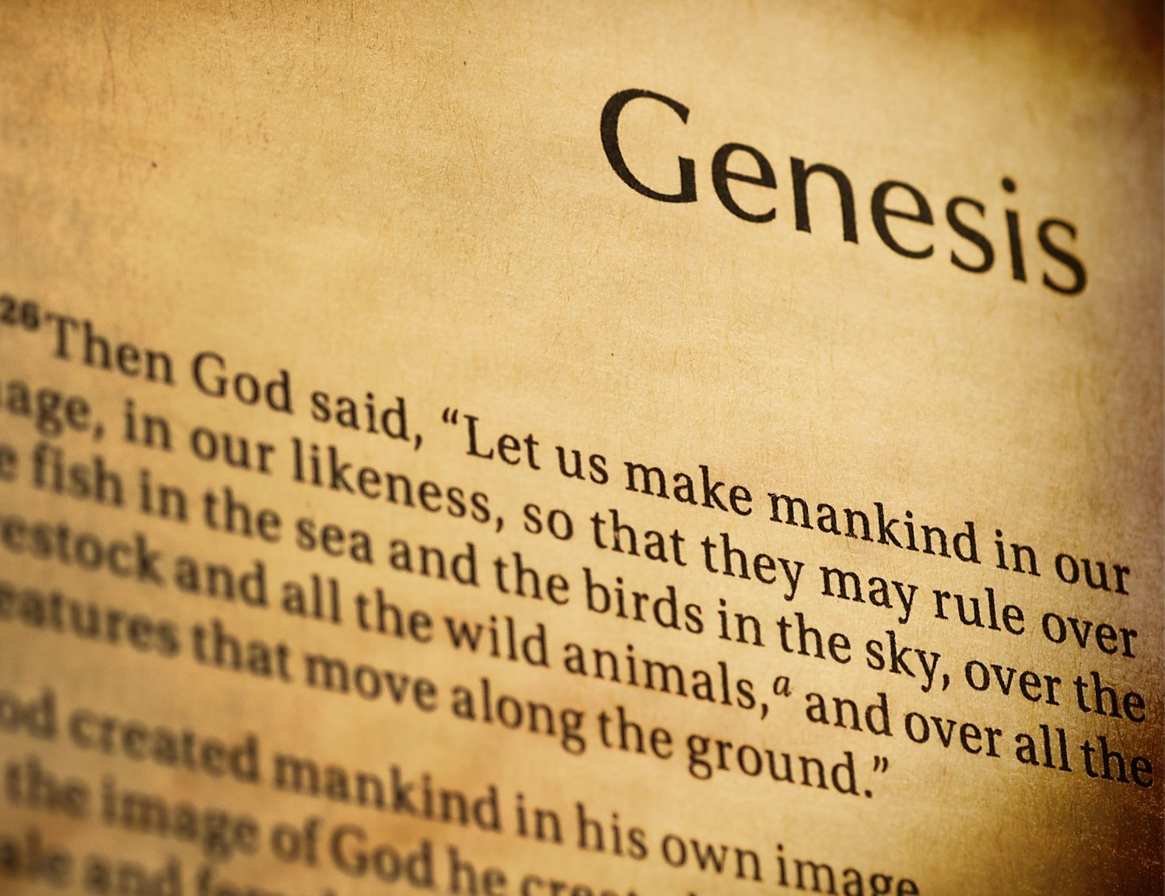
Follow the Architect’s Blueprint for the Wife of His Dreams!
The Bible reveals three keys reasons for this role relationship, all of which are derived from the created order:
First, because the man was created first (1 Tim. 2:13).
Second, because the woman was made from man (1 Cor. 11:8).
Third, because the woman was made for man (1 Cor.11:9).
Submission is neither a punishment for the woman nor an affirmation that she is inferior to her husband.

Slide 7
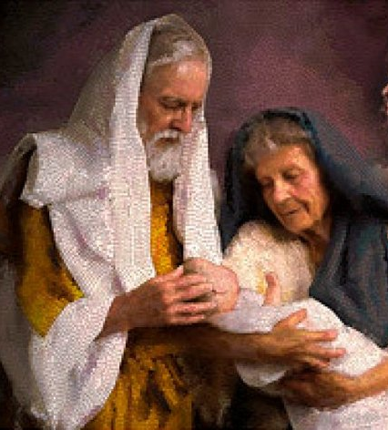
God envisions a wife who will respect her husband
“Nevertheless let each individual among you also love his own wife even as himself; and let the wife see to it that she respects her husband” (Eph. 5:33).
Peter states that Sarah showed that respect in her conduct and in her speech toward Abraham (1 Pet. 3:6).
The Scriptures reveal that a wife can bring great honor to her husband (Prov. 12:4). Her behavior gives him standing in the community (Prov. 31:23).
Her behavior might even lead him to the Lord (1 Pet. 3:1-2).
The woman is able to respect her husband not only because she knows it is God’s will, but because she “trusts” her husband to love her as himself.
If a woman truly believes in her husband’s love, then she can submit “without being frightened by any fear” (1 Pet. 3:6). And when she does, she may find rest in this role. (See Ruth 3:1.)
Notes:
Some women may have difficulty with submission because of a lack of trust in men in general. Perhaps they transfer to their husband the abusive authoritarian power that they saw in their fathers as children. Perhaps their own husbands exercise their rule with abusive power, and this makes trusting them difficult.

Slide 8
God envisions wife who will help her husband
The woman was made to be man’s “helper” (Gen. 2:18).
When we say the Lord is our helper in time of trouble (Ps. 46:1), we do not by that statement make Him our inferior.
Neither does the word “helper” imply the wife is inferior to her husband, but it does suggest that she has been uniquely created to be his complement.
Every Biblical passage that defines the woman’s activities as a wife shows her using those unique gifts God has given her to be the fitting complement to the husband (1 Tim. 5:14; Tit. 2:4-5; Prov. 31:10-12).

Slide 9

God envisions a wife who will serve her husband
As the Scripture calls upon men to sacrificially serve for the benefit of their families, wives are encouraged to fulfill the needs of her husband and family.
In both cases, a successful marriage depends upon a love that serves the other. It is the hallmark of a Spirit-led life (Gal. 5:13).
It should be the wife’s great pleasure to show her love to her husband:
By companionship since she was given to him to prevent his loneliness (Gen. 2:16).
By affection and friendship (Titus 2:4).
By providing sexual fulfillment (Prov. 5:15-20; 1 Cor. 7:1-5).
By making her home a place of peace and comfort (Tit. 2:5; 1 Tim. 5:14).
Notes:
When the man leads with love and the woman submits to him in respect, they experience a beautiful harmony and a mutual blessing. They may face life and set the course of their joined lives in harmony and peace. Each fulfills the position for which he/she is physically and psychologically prepared by God. Each is made to feel a great sense of value and worth as they contribute to the relationship. Each will find their greatest happiness in fulfilling the role God has given them.

Slide 10

Building Our Dream Home: Decorate the Home with Beautiful Furnishings
X
Consider these principles from the Sermon on the Mount.
First, do not let anger cause you to be abusive, but instead make reconciliation a priority (Mt. 5:21-26)!
Jesus urged his disciples to see that selfish anger is not only sinful; it is also destructive.
This is very important to recognize in marriage! Our relationships with our spouses often suffer lasting hurt because we are careless with our words when angry!
When we are upset with our spouses, we need to be careful how we communicate our displeasure.
Sometimes we can attack the person rather than address the problem and the effect it has on us.
Notes:
1. Think about how our world would be changed if everybody practiced the righteousness that Jesus taught in his famous mountain sermon.
Think about how every relationship of our lives would be changed if we all walked in the light! Think about how every marriage would be changed! If we want to have a dream home, we must decorate it with the beautiful furnishings of righteousness.
2. Slide
3. If we are to be righteous, we must not only refrain from abusing others in anger; we must also make efforts to quiet or pacify the anger of our mate – to seek reconciliation. Jesus urged his disciples to honestly acknowledge the dangers that our misdeeds create for others who become angry with us and to take the initiative in pacifying their anger. How can we hope to receive the favor of God in worship while we mistreat others and set the conditions for their sin? What good is it to attend church wanting the favor of God in worship, while we know we are living in disobedience to God and have mistreated someone else – even set the conditions for their sin.
Jesus says instead we should seek reconciliation and seek it quickly!
4. Think of how marriages would be changed if each partner practiced the righteousness Jesus taught! What if every couple determined to never let anger cause them to say or do abusive things? What if each person sought to bring resolution to anger we have caused? If each person in a marriage practiced the righteousness of a true disciple, there would never be angry fights, hurtful words, or unresolved hurts

Slide 11
Our Dream Home: Keep your desire for your spouse alone! (Mt. 5:27-30)
Ye have heard that it was said by them of old time, Thou shalt not commit adultery: 28 But I say unto you, That whosoever looketh on a woman to lust after her hath committed adultery with her already in his heart. 29 And if thy right eye offend thee, pluck it out, and cast it from thee: for it is profitable for thee that one of thy members should perish, and not that thy whole body should be cast into hell. 30 And if thy right hand offend thee, cut it off, and cast it from thee: for it is profitable for thee that one of thy members should perish, and not that thy whole body should be cast into hell.

Slide 12

Our Dream Home: Keep your desire for your spouse alone! (Mt. 5:27-30)
God made us sexual beings. He created the desire of the man for the woman and the woman for the man, but He reserves the fulfillment of that desire for one’s marriage alone.
As marriage partners, we cannot justify any outlet for sexual desire outside our marriages (Heb. 13:4).
Many a marriage and lives have been wrecked by marital infidelity.
Jesus teaches the command not to commit adultery requires that we will take precautions not to give place to lust for another person. We will keep our “eyes” on our spouse and not upon another. We must not allow fantasy a place in our thinking (Job 31:1). Jesus stresses that we can’t take lust lightly.
Notes:
1.Slide
2.Jesus teaches the command not to commit adultery requires that we will take precautions not to give place to lust for another person. We will keep our “eyes” on our spouse and not upon another. We must not allow fantasy a place in our thinking (Job 31:1). Jesus stresses that we can’t take lust lightly. He uses the most dramatic statements to show how we ought to get a handle on it before it leads us to sin. In this society, such opportunities come to us in ways not available in the past – e-mail solicitations; internet chat rooms, internet porn sites can provide avenues for sinful lust that can lead to betrayal. Beware! Many of us learned a song as children that reminds us: “Oh, be careful little eyes what you see...”
3. If every person in a marriage practiced the righteousness of a true disciple, there would never be a relationship between a man or woman and a fellow-worker. There would never be the pain of a betrayal, the feelings of shame and inadequacy that come to those who are the victims of infidelity. There would never be a divorce for fornication!

Slide 13
Our Dream Home: “Till death do us part”
Mean it when you say, “till death do us part” (Mt. 5:31-32)!
Jesus revealed that his disciples would not put away their wives, for doing so, except in the case of fornication, would make them culpable in the adultery that occurs by marrying another!
What if every marriage partner said, “I want my marriage to last for life? I don’t want to be the cause of my spouse committing adultery because of my divorce!”
The divorce lawyers would go out of business.
Bitter custody battles would be non-existent.
Children would no longer feel responsible for the breakup of their parents’ marriage.
Think about how things would be changed if every marriage person practiced the righteousness of a disciple!

Slide 14

Communicate with transparency and honesty! (Mt. 5:33-37)
Again, ye have heard that it hath been said by them of old time, Thou shalt not forswear thyself, but shalt perform unto the Lord thine oaths: 34 But I say unto you, Swear not at all; neither by heaven; for it is God's throne: 35 Nor by the earth; for it is his footstool: neither by Jerusalem; for it is the city of the great King. 36 Neither shalt thou swear by thy head, because thou canst not make one hair white or black. 37 But let your communication be, Yea, yea; Nay, nay: for whatsoever is more than these cometh of evil.

Slide 15
Communicate with transparency and honesty! (Mt. 5:33-37)
Jesus wanted his disciples to be people of integrity in their speech. They didn’t have to resort to oaths to be believed because they told the truth all the time!
David Mace, the past president of the American Association of Marriage counselors, has said: “Poor communication is the main problem in 86% of all troubled marriages.”
Honest communication means that we reveal our true thoughts in marriage. We should not expect our mate to read our minds; nor should we try to read their minds rather than ask for information. Honest communication means that we speak the truth even when the disclosure may be painful.
Do not insist upon the truth and punish the other person for speaking it
The speaker must reveal his/her thoughts honestly, tactfully, clearly, honestly. The listener must hear them patiently, with an open heart, and with a desire to respond lovingly.
Notes:
The Law permitted oaths in God's name but urged God’s people to never take His name in vain by swearing falsely (or using it frivolously). The Pharisees had apparently marshaled this prohibition to support the idea that integrity in speech was only binding when God was the object of the promise. Another text lends itself to the idea that they even made oaths or promises binding based on the sacred object referenced in the oath (Cf. Mt. 23:16-22)! In contrast, Jesus wanted his disciples to be people of integrity in their speech. They didn’t have to resort to oaths to be believed because they told the truth all the time!
2. David Mace, the past president of the American Association of Marriage counselors, has said: “Poor communication is the main problem in 86% of all troubled marriages.” Think of the value of honest and transparent communication in marriage. Honesty communication means that there are no hidden relationships or secret activities to be later discovered with great hurt and feelings of disloyalty.
Honest communication means that we reveal our true thoughts in marriage. We should not expect our mate to read our minds; nor should we try to read their minds rather than ask for information. Honest communication means that we speak the truth even when the disclosure may be painful. As marriage partners, we need to set the conditions for honest communication. Do not insist upon the truth and punish the other person for speaking it. Instead, use that information to make things better. Honest communication means that we keep our promises. When we fail to keep our word, it makes our mates feel disrespected and unvalued. If we can back out of our promises to them, it says they are not very important to us. Something else is more important.
3. In short, real communication requires both a speaker and a receiver. The speaker must reveal his/her thoughts honestly, tactfully, clearly, honestly. The listener must hear them patiently, with an open heart, and with a desire to respond lovingly. Only then can real honest communication take place.

Slide 16
Be more concerned about generosity than equality! (Mt. 5:38-42)
Ye have heard that it hath been said, An eye for an eye, and a tooth for a tooth: 39 But I say unto you, That ye resist not evil: but whosoever shall smite thee on thy right cheek, turn to him the other also. 40 And if any man will sue thee at the law, and take away thy coat, let him have thy cloke also. 41 And whosoever shall compel thee to go a mile, go with him twain. 42 Give to him that asketh thee, and from him that would borrow of thee turn not thou away.

Slide 17
Be more concerned about generosity than equality! (Mt. 5:38-42)
Jesus was concerned about the spirit of our relationships.
Do we build them on grace or justice? Building a marriage on grace rather than strict justice is the grounds of a forgiving relationship (Cf. Col. 3:12-13)!
The eye-for-an-eye mentality will destroy any relationship! Building a marriage on grace is also the grounds of a giving relationship.
Husbands and wives need the mentality not to say, “I will if you will,” or “I will only give if you will give;” but rather, “I will give more. I will go further.”
Of course, generosity can be exploited. A giving spouse can be abused, taken advantage of, and even neglected. So every person who enjoys a generous mate should at least ask themselves, “Am I willing to be as generous and giving? Or am I taking advantage of my mate?”
Notes:
1. Jesus was concerned about the spirit of our relationships.
Do we build them on grace or justice? Building a marriage on grace rather than strict justice is the grounds of a forgiving relationship (Cf. Col. 3:12-13)!
The eye-for-an-eye mentality will destroy any relationship! Building a marriage on grace is also the grounds of a giving relationship.
Husbands and wives need the mentality not to say, “I will if you will,” or “I will only give if you will give;” but rather, “I will give more. I will go further.”
Of course, generosity can be exploited. A giving spouse can be abused, taken advantage of, and even neglected. So every person who enjoys a generous mate should at least ask themselves, “Am I willing to be as generous and giving? Or am I taking advantage of my mate?”
2.

Slide 18
Keep showing love when the other person is least deserving of it!
Mt 5:43-48 Ye have heard that it hath been said, Thou shalt love thy neighbour, and hate thine enemy. 44 But I say unto you, Love your enemies, bless them that curse you, do good to them that hate you, and pray for them which despitefully use you, and persecute you; 45 That ye may be the children of your Father which is in heaven: for he maketh his sun to rise on the evil and on the good, and sendeth rain on the just and on the unjust. 46 For if ye love them which love you, what reward have ye? do not even the publicans the same? 47 And if ye salute your brethren only, what do ye more than others? do not even the publicans so? 48 Be ye therefore perfect, even as your Father which is in heaven is perfect.

Slide 19

Keep showing love when the other person is least deserving of it!
Jesus in Matthew 5:43-48 extends the principle of grace he had previously expounded.
What do you do when someone else is at their worst? Do you become like them? Or, do you keep doing what is right?
As husbands and wives, we need to recognize that everybody has a bad day (work-related or family-related stress, waves of sadness from a past hurtful experience, biological changes, and physical fatigue).
These things and more can cause both husbands and wives to be grumpy, moody, unresponsive, and even inconsiderate.

Slide 20
Keep showing love when the other person is least deserving of it!
If we can “love our enemies” who do far worse to us, then surely we can love the person we have committed to living with for life!
Jesus reminded His disciples of the nature of God’s love.
Does God love people based on how deserving they are? Or does He love them because of who He is! It is the latter.
Jesus encouraged His disciples to love others unconditionally, to let their love “be perfect” as that of their heavenly Father.
That’s why they could do good to their enemies and pray for those who abused them.
But someone says, “I don’t think I should be a doormat. My husband/wife doesn’t deserve such sacrifices.”
Yes, you may be right; but God does! It is God’s unconditional love for us that empowers us to love others unconditionally (Eph. 5:1-2)

Slide 21
Serve your mate for God’s glory and not your own (Mt. 7:1-18)
Judge not, that ye be not judged.
2 For with what judgment ye judge, ye shall be judged: and with what measure ye mete, it shall be measured to you again.
3 And why beholdest thou the mote that is in thy brother's eye, but considerest not the beam that is in thine own eye?
4 Or how wilt thou say to thy brother, Let me pull out the mote out of thine eye; and, behold, a beam is in thine own eye?
5 Thou hypocrite, first cast out the beam out of thine own eye; and then shalt thou see clearly to cast out the mote out of thy brother's eye.
6 Give not that which is holy unto the dogs, neither cast ye your pearls before swine, lest they trample them under their feet, and turn again and rend you.
7 Ask, and it shall be given you; seek, and ye shall find; knock, and it shall be opened unto you:
8 For every one that asketh receiveth; and he that seeketh findeth; and to him that knocketh it shall be opened.
9 Or what man is there of you, whom if his son ask bread, will he give him a stone?

Slide 22
Serve your mate for God’s glory and not your own (Mt. 7:1-18)
10 Or if he ask a fish, will he give him a serpent?
11 If ye then, being evil, know how to give good gifts unto your children, how much more shall your Father which is in heaven give good things to them that ask him?
12 Therefore all things whatsoever ye would that men should do to you, do ye even so to them: for this is the law and the prophets.
13 Enter ye in at the strait gate: for wide is the gate, and broad is the way, that leadeth to destruction, and many there be which go in thereat:
14 Because strait is the gate, and narrow is the way, which leadeth unto life, and few there be that find it.
15 Beware of false prophets, which come to you in sheep's clothing, but inwardly they are ravening wolves.
16 Ye shall know them by their fruits. Do men gather grapes of thorns, or figs of thistles?
17 Even so every good tree bringeth forth good fruit; but a corrupt tree bringeth forth evil fruit.
18 A good tree cannot bring forth evil fruit, neither can a corrupt tree bring forth good fruit.

Slide 23
Serve your mate for God’s glory and not your own (Mt. 7:1-18)
What motivates us to serve?
Do we spring into action if someone is around who could see our kindness or helpfulness, but become negligent or disinterested when no one is around?
What would we be willing to do for our husbands/wives if we knew no one would know what we did for them?
Would we be as willing to serve if no one would praise us for being a good husband or wife?
As husbands and wives, we need to serve for God’s glory and not our own.
Notes:
The Pharisees desired to do good things to be seen and commended by others. They prayed where they could be seen by others. They “sounded the trumpet” when they gave alms. They disfigured their faces when they fasted. They wanted the praise of men. So then it is appropriate to ask, “Were they really serving God in what they were doing, or were they engaging in self-serving acts to solicit praise and congratulation from others?” Obviously, it was the latter. In contrast, Jesus taught his disciples that service for the glory and approval of God was sufficient for the truly righteous. To know that we have done what is right in His eyes and that we have glorified Him and will receive His reward is all that matters. This principle is quite applicable to marriage.
Slide
As husbands and wives, we need to serve for God’s glory and not our own. Even in marriage, we need the mindset that says I want to do what pleases God, and it is his reward that I seek in obeying him in marriage. Serving our mates out of selfless motivations manifests the highest level of love for them. We act for their sakes; we act for their good; and we find delight in serving them for no other reason than they will be blessed by our service. This is the noblest love that we can show to our husband or wife!

Slide 24

Manage your finances with faith and wisdom
Probably one of the top ten causes of marital conflict is disagreement about money.
Families often fall prey to materialism in their quest for happiness.
Often marriages suffer from too much time apart and conflicts over what to buy or not to buy.
Moreover, too often couples get deeply in debt seeking to have too much too soon, and that exacerbates the problem.
The home becomes a place of tension and conflict rather than support and peace as bills accumulate and money to pay them is short.
Many disagreements could be remedied if people would think more spiritually and wisely about material things.
Notes:
Probably one of the top ten causes of marital conflict is disagreement about money. Families often fall prey to materialism in their quest for happiness. They buy into the idea that the more things they have, the happier they will be. And so, they work extra hours to accumulate things. Often marriages suffer from too much time apart and conflicts over what to buy or not to buy.
Moreover, too often couples get deeply in debt seeking to have too much too soon, and that exacerbates the problem. The home becomes a place of tension and conflict rather than support and peace as bills accumulate and money to pay them is short. Another source of tension between couples involves disagreements about spending versus saving. Many disagreements could be remedied if people would think more spiritually and wisely about material things.

Slide 25
Manage your finances with faith and wisdom
Jesus stressed two principles in His teaching in Matthew 6:
First, we need to lay up treasure in heaven, not on earth (Mt. 6:19-21).
Second, we need to seek first God’s kingdom and righteousness (Mt. 6:33).
Both principles can help cure many marital problems.
The happiest couples are not those living in the nicest house, possessing the newest and more expensive car, and taking the most expensive vacations.
Divorce among the wealthy is rampant.
Don’t be deceived. Love God! Love your mate, but beware of the love of money! It can ruin it all!
Notes:
Jesus stressed two principles in His teaching in Matthew 6: First, we need to lay up treasure in heaven, not on earth (Mt. 6:19-21). Jesus teaches us not to make the accumulation of money an “end” in itself but rather to let money and things be a “tool” to accumulate spiritual treasures by using them for the good of God’s kingdom. Pursuing wealth can make us slaves of things and keep us from being good servants of God! Consequently, it establishes a value system in marriage that will result in the problems we just mentioned.
Second, we need to seek first God’s kingdom and righteousness (Mt. 6:33). The endless quest for wealth sometimes betrays a lack of trust in the provision of God. Jesus taught his disciples to live with dependence upon Him and make obedience to Him primary in our lives. Of course, it is foolish, not faithful, to neglect to prepare for our future by anticipating future needs and by saving for life’s emergencies or for failing health that might render us incapable of taking care of ourselves.
Both principles can help cure many marital problems. The happiest couples are not those living in the nicest house, possessing the newest and more expensive car, and taking the most expensive vacations. Divorce among the wealthy is rampant. Don’t be deceived. Love God! Love your mate, but beware of the love of money! It can ruin it all! If you live with trust in God’s provision, you can jointly share in good works for the benefit of others, not thinking that such sacrifices will somehow jeopardize your future. You can, at the same time, be financially prepared for life’s uncertainties.

Slide 26
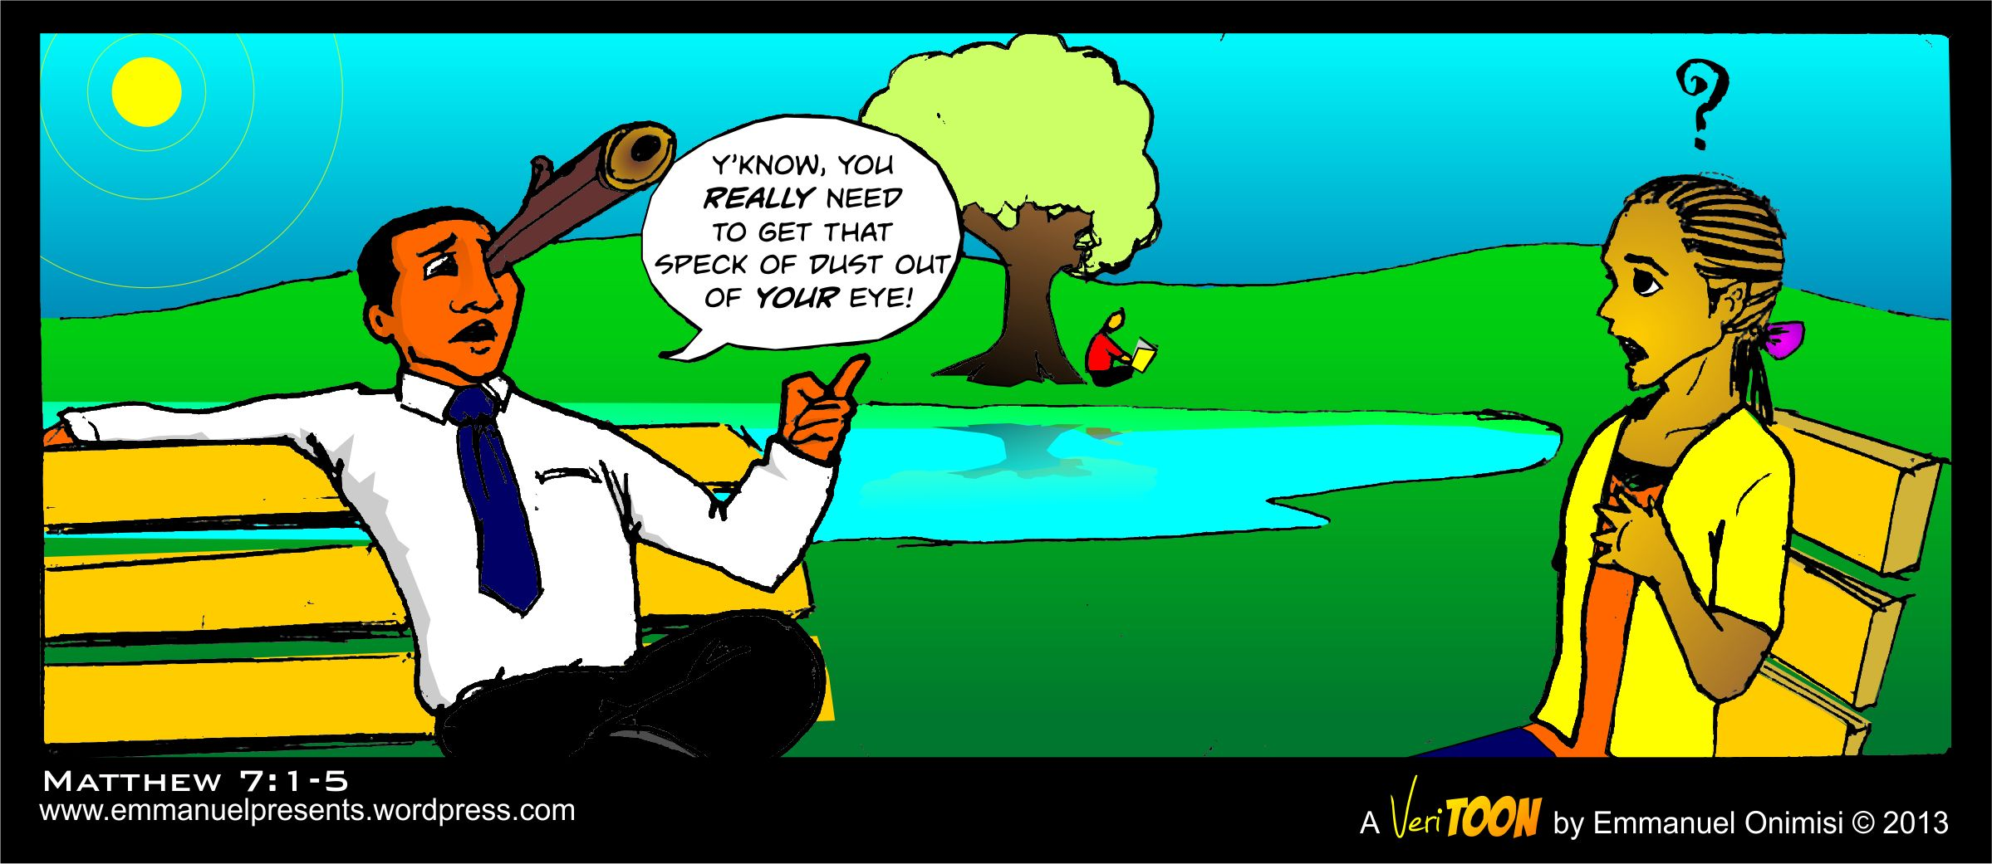
Live with an awareness of your own imperfections.
Jesus taught his disciples not to judge (Mt. 7:1-2).
It is captured in the essential description: “And why do you look at the speck that is in your brother’s eye, but do not notice the log that is in your own eye?” Or how can you say to your brother, ‘Let me take the speck out of your eye,’ and behold, the log is in your own eye? You hypocrite, first take the log out of your own eye, and then you will see clearly to take the speck out of your brother’s eye” (Mt. 7:3–5, NASB).
How valuable such a principle is in marriage!
How can we hope to bring out the best in our mates if we are self-righteous and constantly condemning?
One of the fundamental motivations of forgiveness is the personal realization that we have faults and need forgiveness from our mate too. T
he person who is not honest with his own faults will likely be harsh and unforgiving with his/her mate.
Notes:
Jesus taught his disciples not to judge (Mt. 7:1-2). These words have often been misinterpreted and misapplied. Contextually they refer to the tendency of people to condemn others while they sin more grievously themselves. It is captured in the essential description: “And why do you look at the speck that is in your brother’s eye, but do not notice the log that is in your own eye?” Or how can you say to your brother, ‘Let me take the speck out of your eye,’ and behold, the log is in your own eye? You hypocrite, first take the log out of your own eye, and then you will see clearly to take the speck out of your brother’s eye” (Mt. 7:3–5, NASB).
How valuable such a principle is in marriage! In the first place, how can we hope to bring out the best in our mates if we are self-righteous and constantly condemning? Our mates will be far more encouraged to do right by seeing your godly example than in getting a hypocritical lecture on how sorry they are! One of the fundamental motivations of forgiveness is the personal realization that we have faults and need forgiveness from our mate too. The person who is not honest with his own faults will likely be harsh and unforgiving with his/her mate.

Slide 27
Practice daily the “golden rule.”
“Therefore, however you want people to treat you, so treat them, for this is the Law and the Prophets” (Mt. 7:12, NASB).
Practice the golden rule every day.
Assess your actions by it.
What if my mate treated me like I treat them?
Before you say something, ask yourself, “How would I like to be spoken to like that?”
Before you act, ask yourself, “Would I want to be treated that way?”
I’ve often heard the aged who have been successfully married for many years appeal to this simple rule, “Treat your mate like you would want to be treated.”

Slide 28

Conclusion
As children of light envisioning our dream homes, let us build on the solid foundation that God has planned.
We must put faith in God in our marriages and follow God’s plan.
The real key to a happy marriage is a righteous marriage – or more properly, the union and interaction of two righteous people who want to please God.
When we create a culture of righteousness in our homes, we prepare the way for a true dream home!
The wife should follow God’s blueprint for her role, and let both husband and wife seek to decorate their homes with the beautiful furnishing of righteousness.
Your home will be a thing of amazing beauty as you walk in the light in your marriage.

